Slide 1

Web
Development
Project Report
By : Shruti Ghogare

Slide 2

Introduction
In this web development internship for a period of 1 month , I have completed 2 projects mentioned below :-
Basic Project - Imager Slider
Advance Project – Soil Farming Agent
The technologies used are :-
HMTL ,CSS (frontend/styling)
JavaScript
phpmyadmin (database)
Generative AI, on the other hand, can be thought of as the next generation of artificial intelligence. It's a form of AI that can create something new.

Slide 3
Image slider
Problem Statement
An image slider, also known as an image carousel is a user interface component used on websites to display a series of images in a in a visually appealing way. The proposed application implement navigation controls (previous and next buttons) that allow users to manually navigate through the images in the slider. It ensures that the slider loops back to the first image when reaching the end.
The ‘Auto’ button automatically slides to the next image after a certain time interval (e.g., every 3 seconds).
.

Slide 4
Methodology
The techniques and methods used in image slider are :-
HTML Structure: Creates the HTML structure for the image slider. It has a container for the slider, navigation buttons (previous and next), and a section to display the images (Index.html file)
CSS Styling: Style the image slider using CSS. This includes defining the size, positioning, and transitions for the images and navigation buttons. It ensures that the slider looks visually appealing (Style.css)

Slide 5
Methodology
JavaScript Functionality: Implements the JavaScript logic for the image slider (script.js)
It contains :-
Image Array: consists an array of 5 images that will be displayed in the slider (const images)
functions to display the first image when the page loads. Allow users to click on "Next" and "Previous" buttons to navigate through the images.
Automatic Slideshow: Add an option to make the slider automatically transition to the next image after a certain interval (e.g., every 3 seconds).

Slide 6
Working
Execute the index.html in any web browser.
The variables are set as:-
const firstImage = 0;
const lastImage = images.length -1;
let currentImage = 0;
let rotate;
The updateImage() function updates the image whenever ‘previous’ or ‘next’ buttons are clicked.
The ‘autoBtn’ changes the image every 3 seconds
2
3
4
Various AI algorithms then return new content in response to the prompt.
Content can include essays, solutions to problems, or realistic fakes created from pictures or audio of a person.

Slide 7
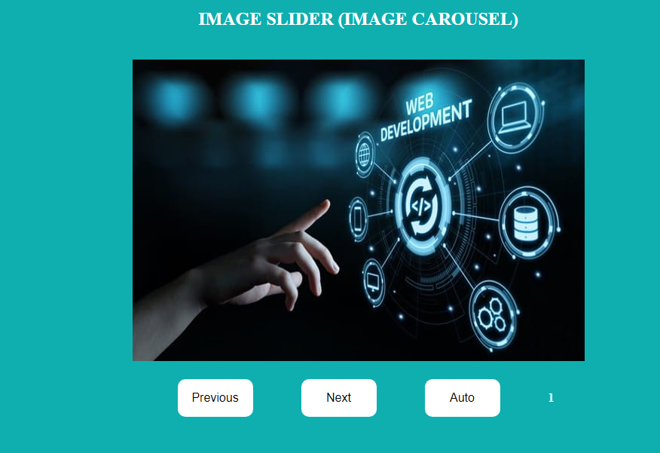
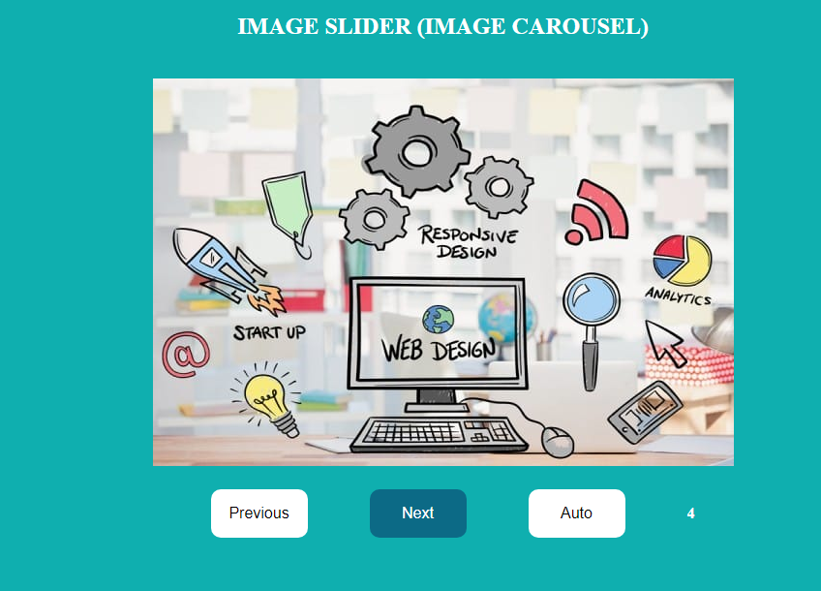
Results
3
4
Content can include essays, solutions to problems, or realistic fakes created from pictures or audio of a person.
Index.html
Next Button

Slide 8
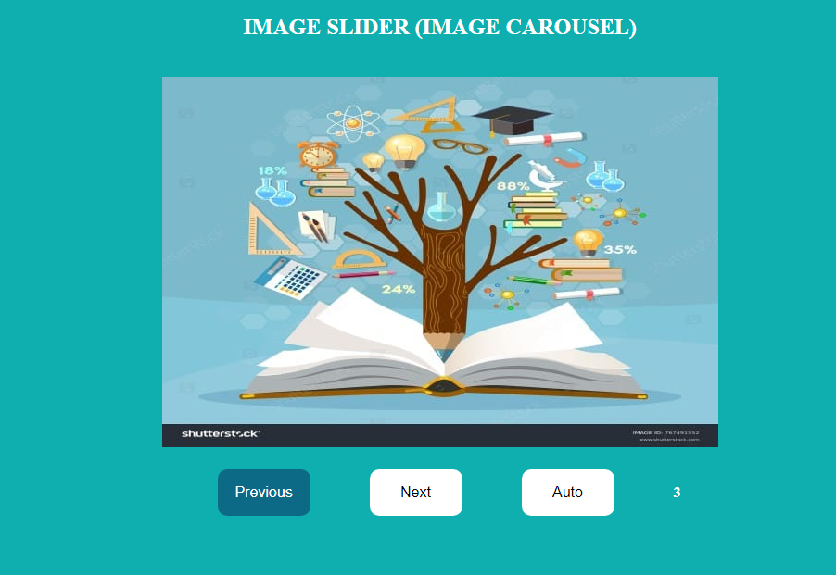
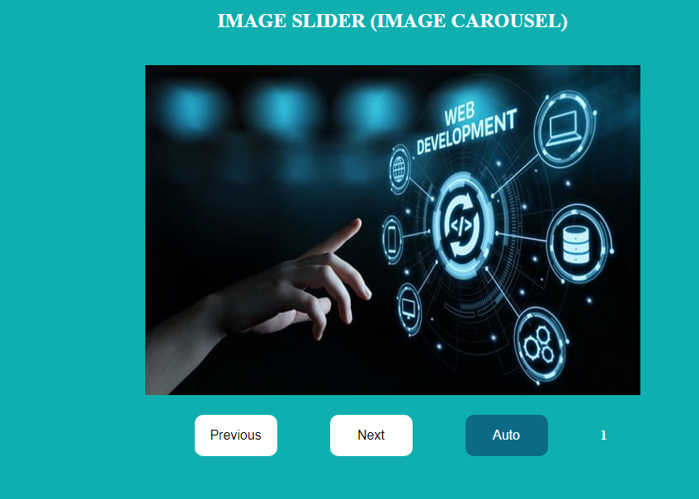
Results
3
4
Content can include essays, solutions to problems, or realistic fakes created from pictures or audio of a person.
Previous Button
Auto Button

Slide 9
Soil Farming Agent
Problem Statement
Soil farming, also known as soil management, is a crucial practice aimed at maintaining and improving soil health, which is essential for sustainable agriculture. Effective soil management ensures long-term agricultural productivity, environmental health, and food security.
The proposed application admin would update the information in the portal and crop/seed distributor details with the help of soil and crop specialists. These soil and distributor details can be viewed by the user.
4

Slide 10
Requirements
The software requirements are :-
Frontend
html
css
bootstrap
Backend
php
Mysql
Php tools
xampp-windows
4

Slide 11
System Modules
The system modules include :-
ADMIN
Login
Post Soil Details
Post Distributor Details
USER
Register
Login
View Soil Details
View Distributor Details
4

Slide 12
Methodology & Working
Execute the ‘1.php’ file present in the index of soil.
This leads to the home page of soil farming agent. Click the ‘know us’ button o know about the website. The navigation bar contains the ‘login’ button , which allows user and admin login.
If user or admin does not have account, ‘Register’ allows us to add new user or admin.

Slide 13
Methodology & Working
The admin login allows us to :-
View total soil
View total distributors
Add soil
Add distributor
Manage soil
Manage distributor
The user login allows :-
View soil details
View distributors

Slide 14

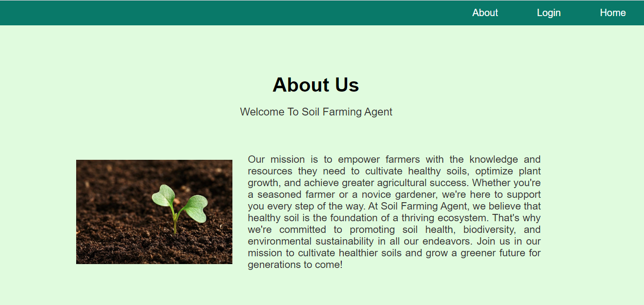
Results
Home page
About us page

Slide 15
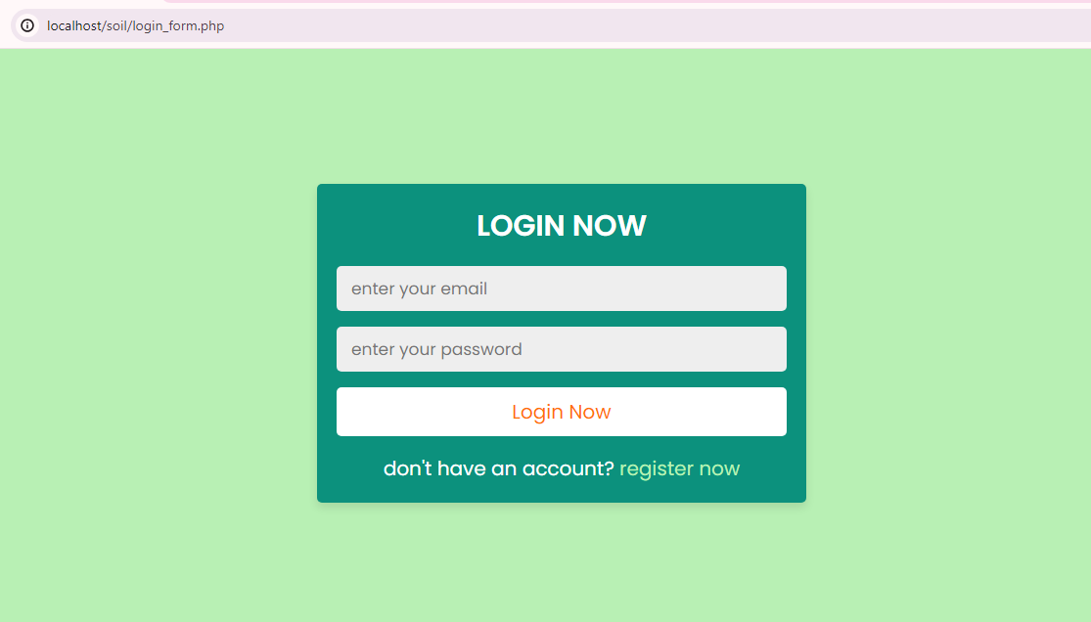
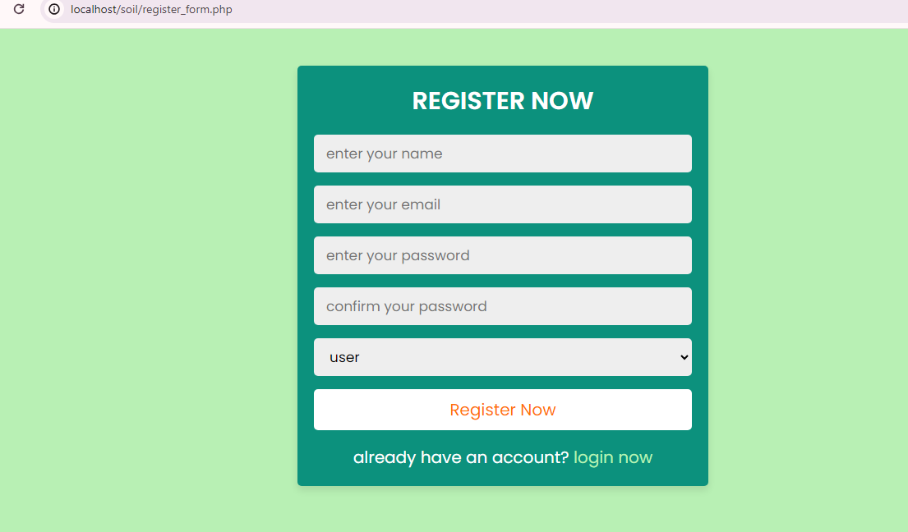
Results
Login
Registration

Slide 16
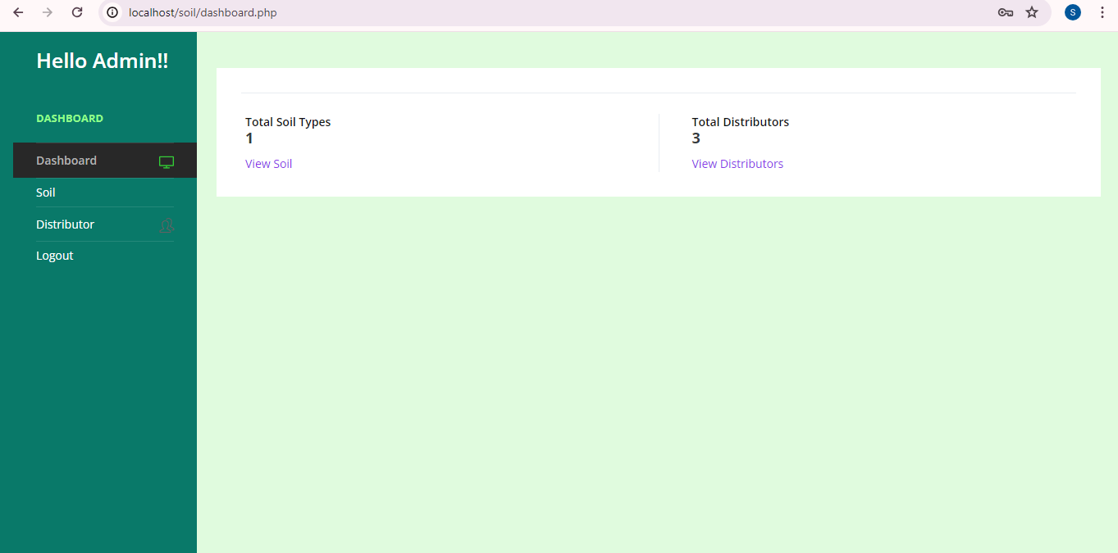
Results
Admin Dashboard

Slide 17
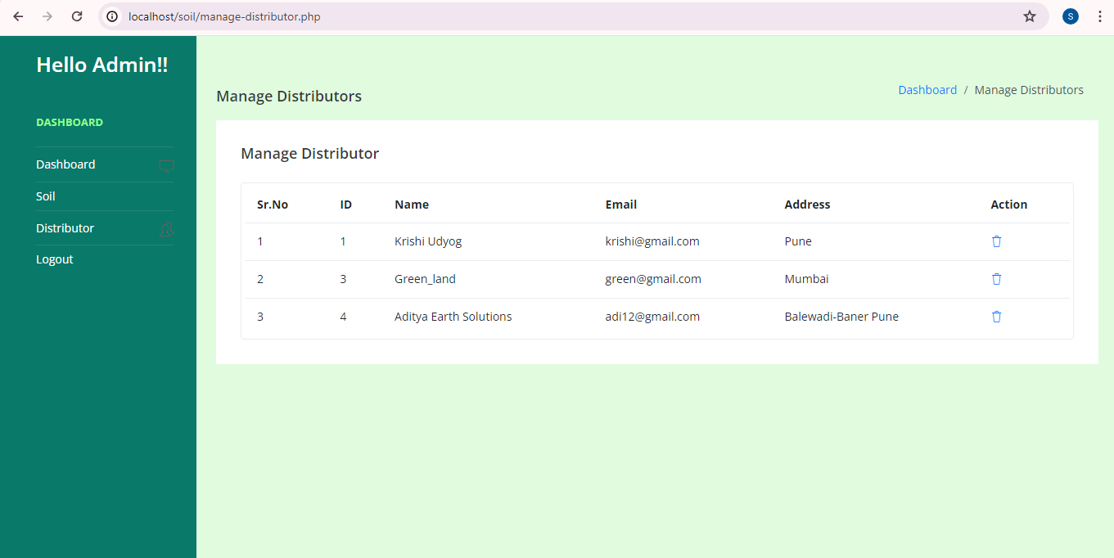
Results
Manage Distributor Details

Slide 18
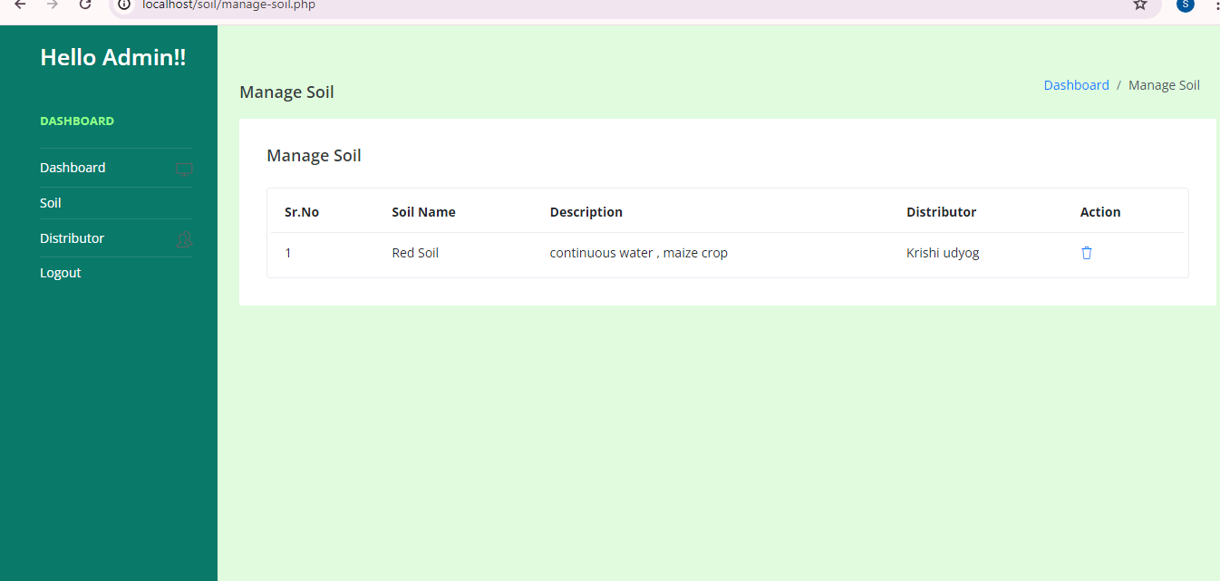
Results
Manage Soil Details

Slide 19
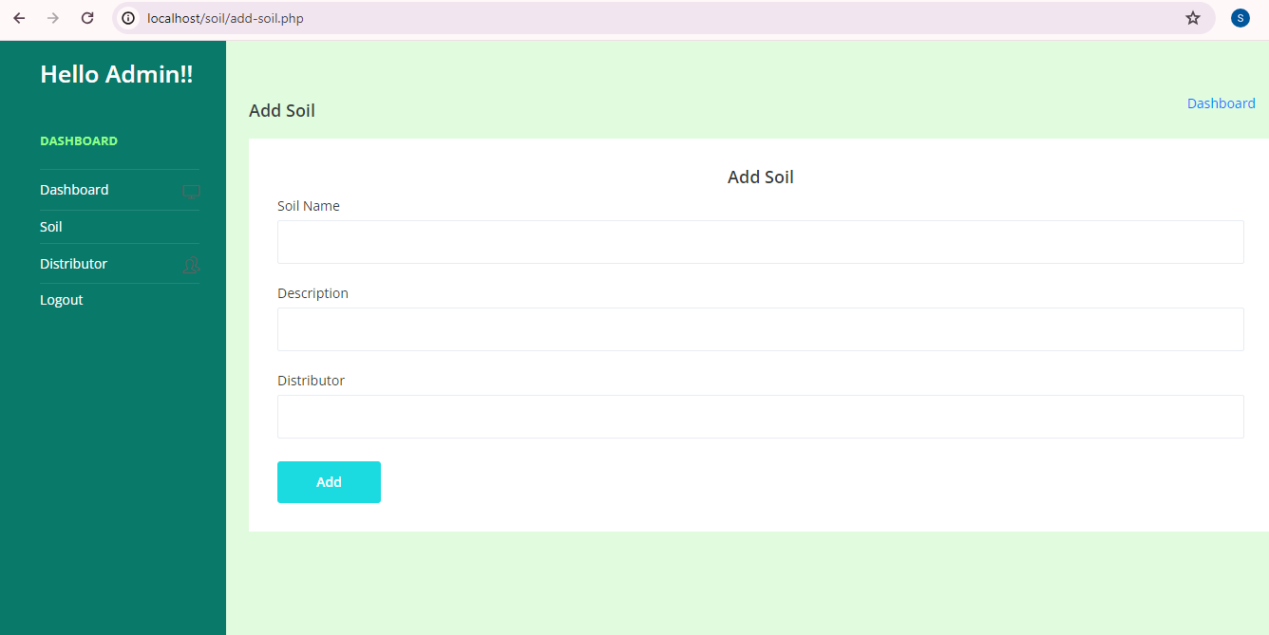
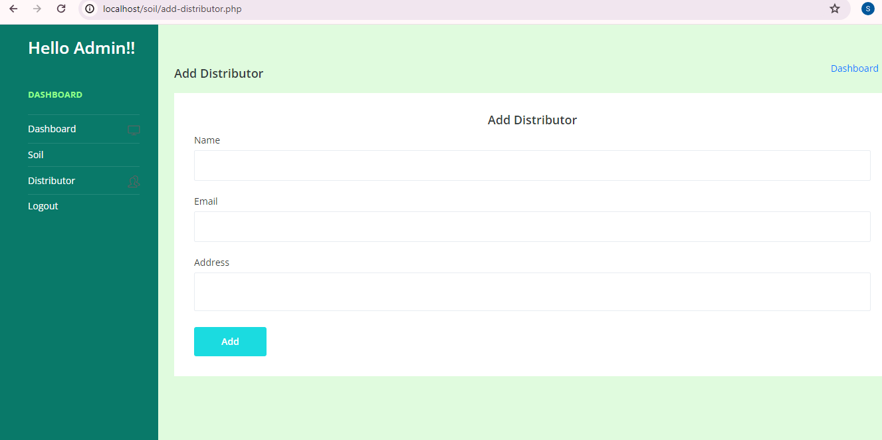
Results
Add soil
Add distributor

Slide 20
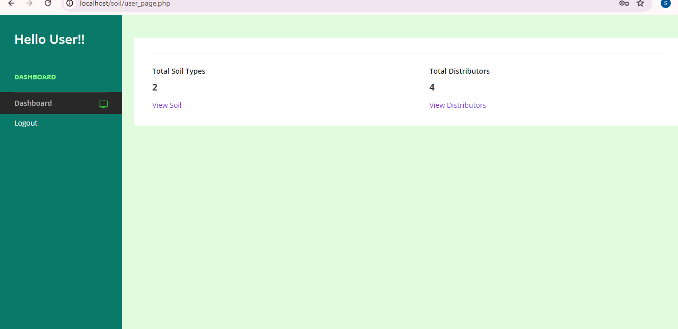
Results
User Dashboard

Slide 21
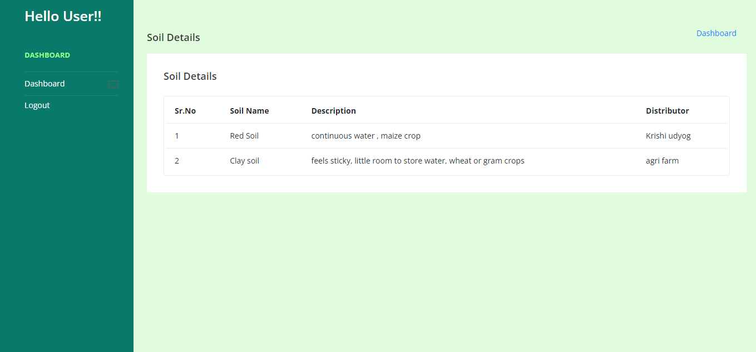
Results
View Soil Details

Slide 22
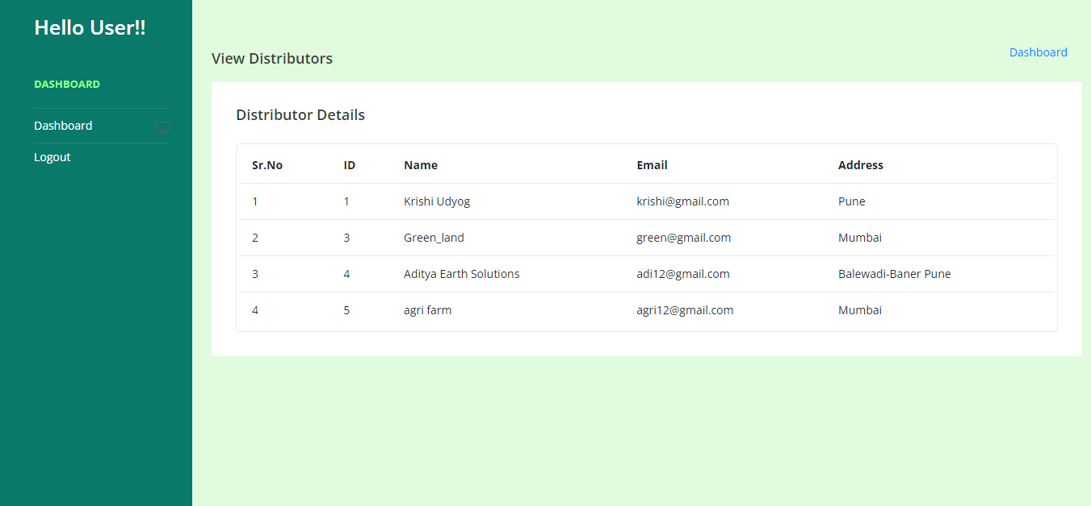
Results
View Distributor Details

Slide 23
Thank you

